Slide 1

Employee Travel Booking
Created By Anjali Patil, Snehal Barge, Sanjana Mishra, Diksha Rambhad, Tanvi Dhasade

Slide 2
CONTENTS
01
02
03
04
DIAGRAMS UML Diagrams
DATABASE ER Diagram
ABOUT Functionalities of ETB
SNIPPETS Screenshots of our Project

Slide 3
ABOUT ETB
AIM
WHY ETB?
WORKING
Aims at developing an Employee Travel Booking Application. Employee Travel Booking allows Employees to place requests for booking business travel tickets.
In current corporate world, Employees are often required to travel to Domestic as well as international locations based on business requirements. ETB will help employees to raise or submit a ticket for travelling to the required location.
Employees will raise or place the travel request. Manager can approve, reject the request. Once manager approves the request travel agent will confirm the travel or can make the status as Bookings not available.

Slide 4
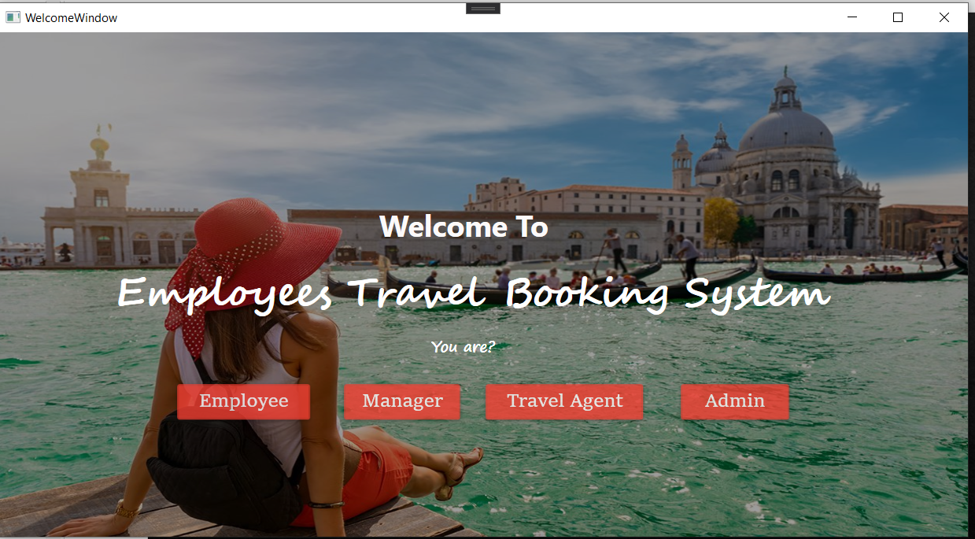
SNIPPETS

Slide 5
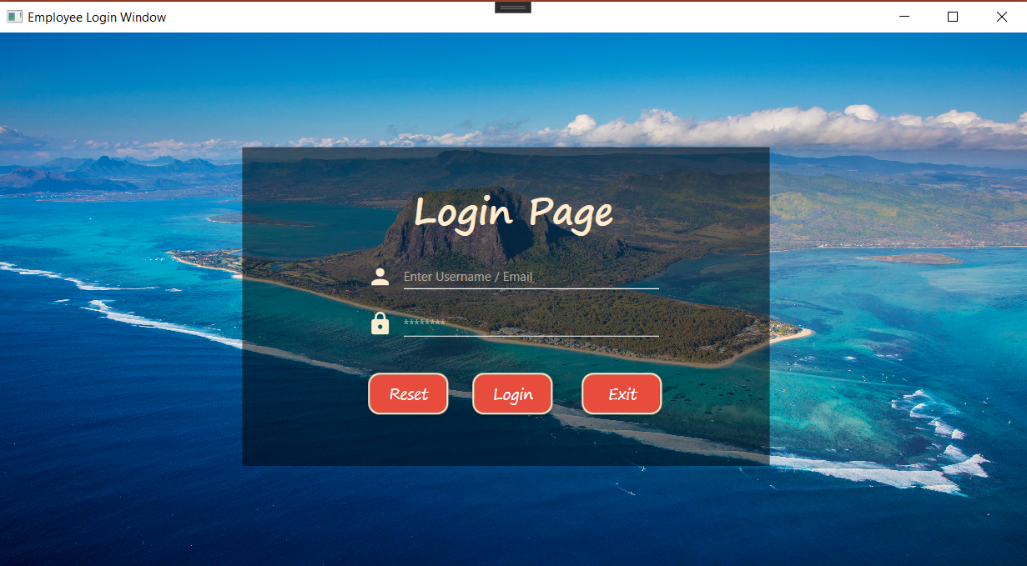

Slide 6
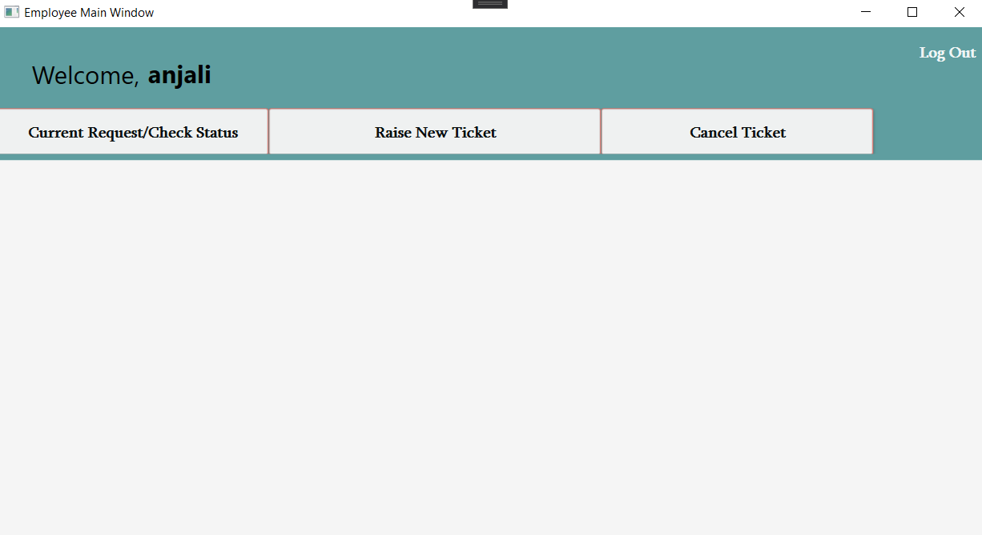

Slide 7
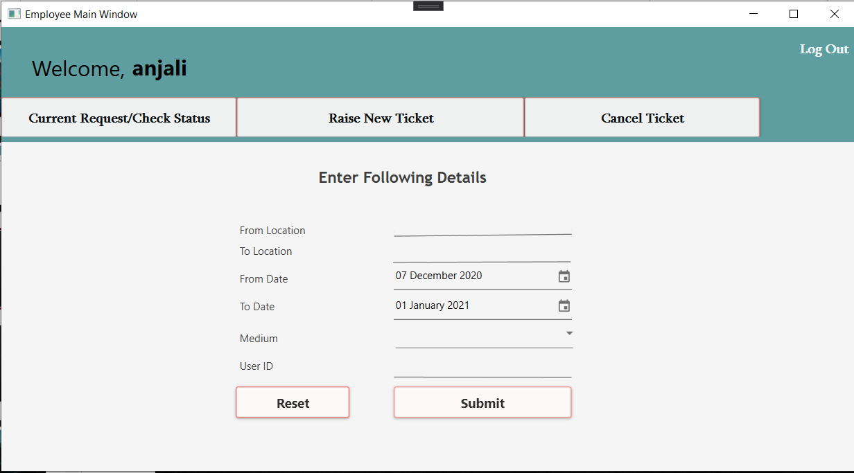

Slide 8
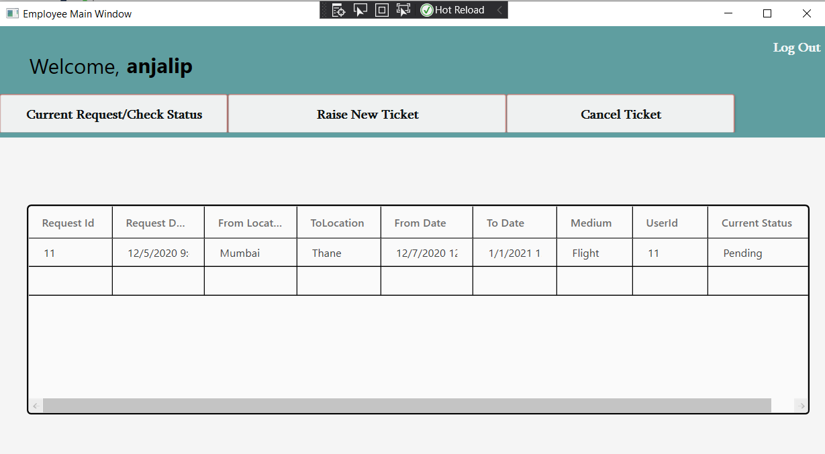

Slide 9
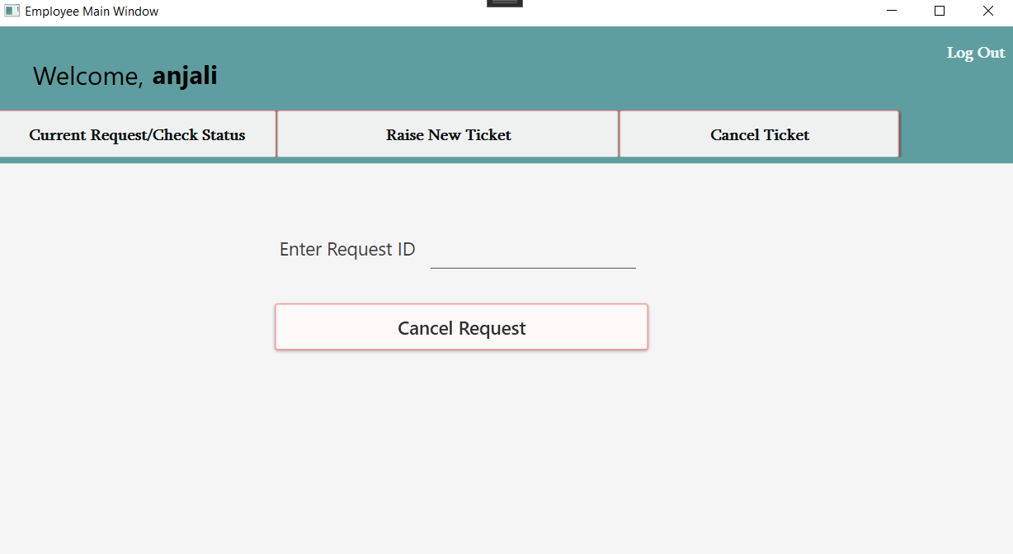

Slide 10
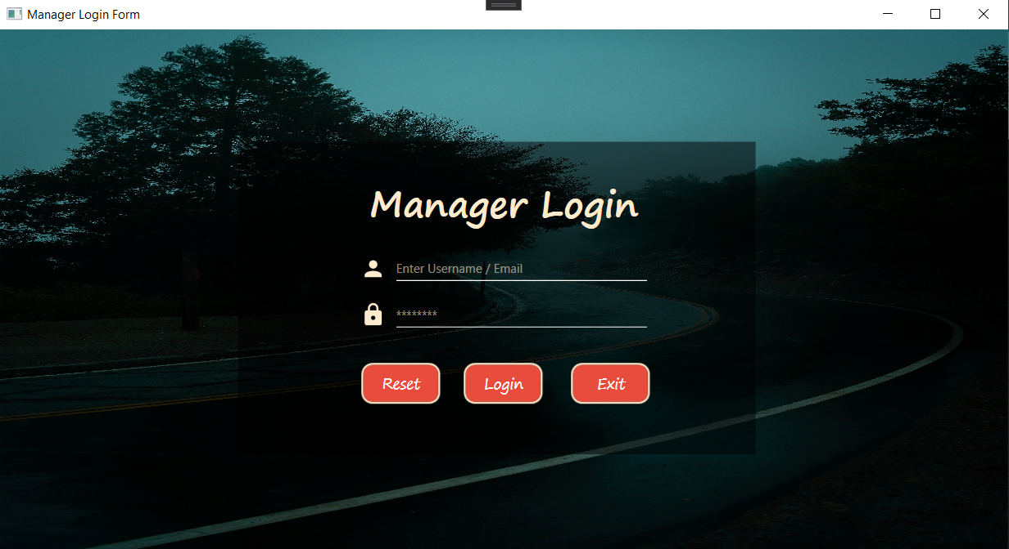

Slide 11
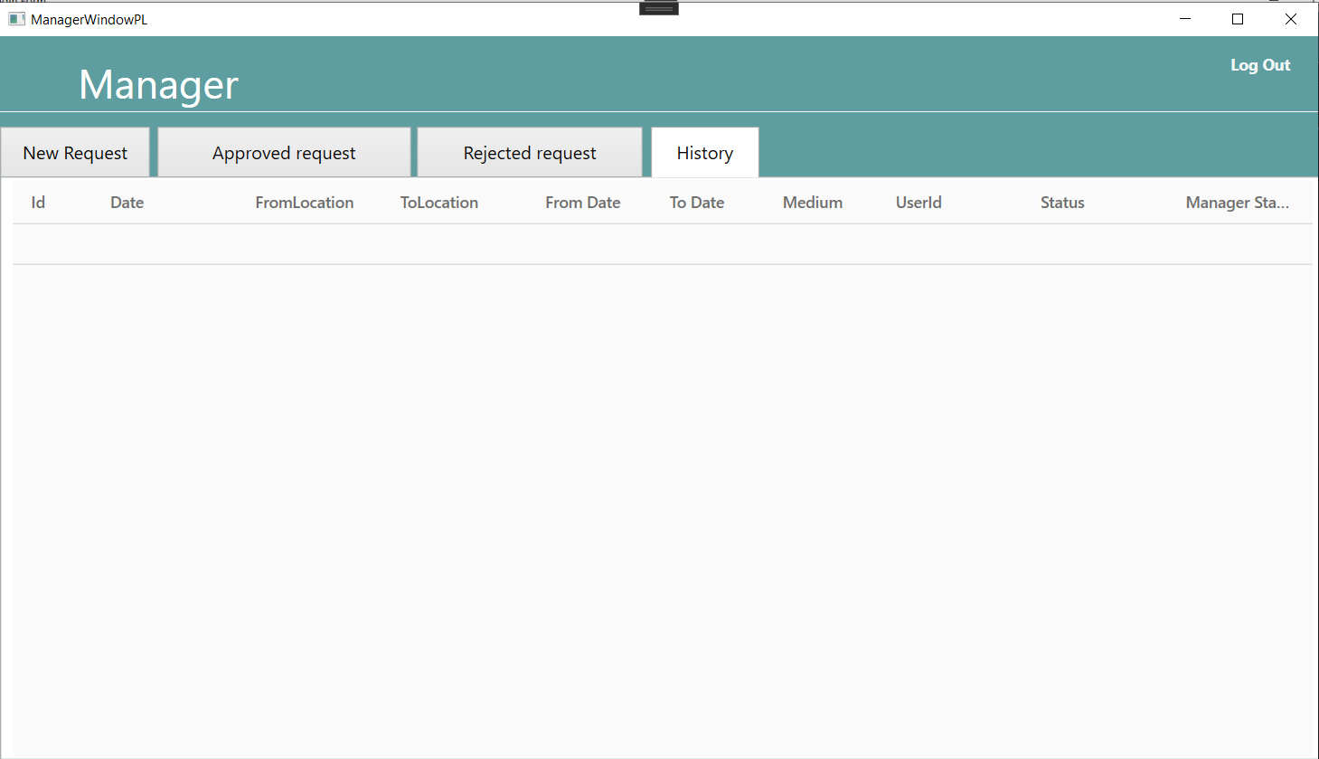

Slide 12
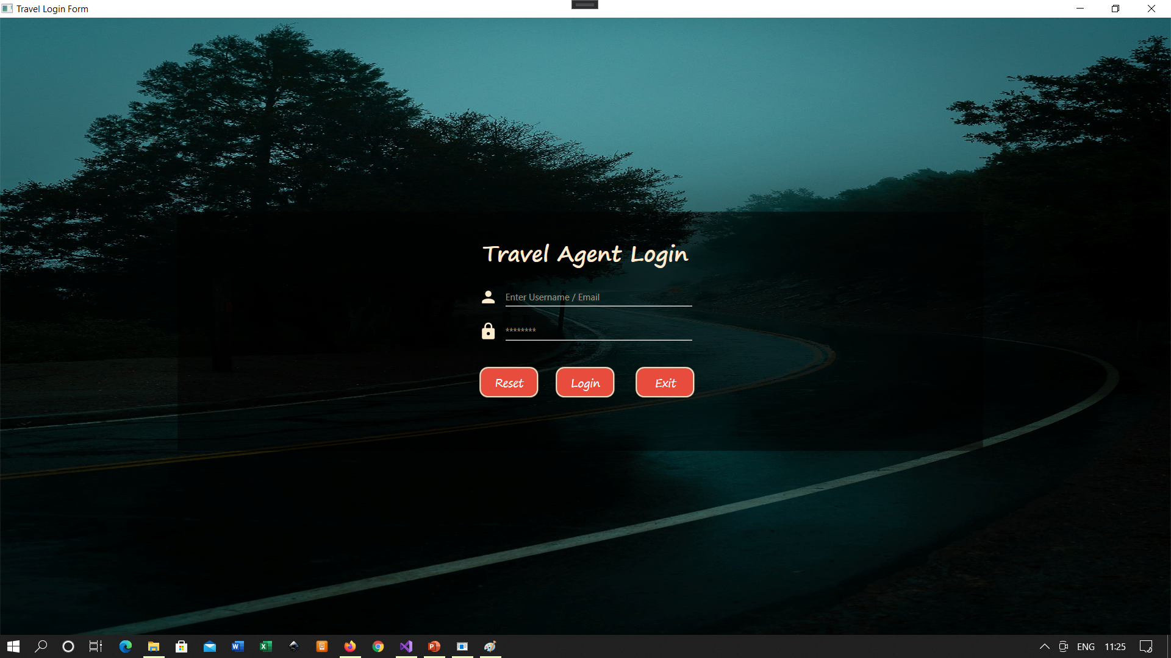

Slide 13
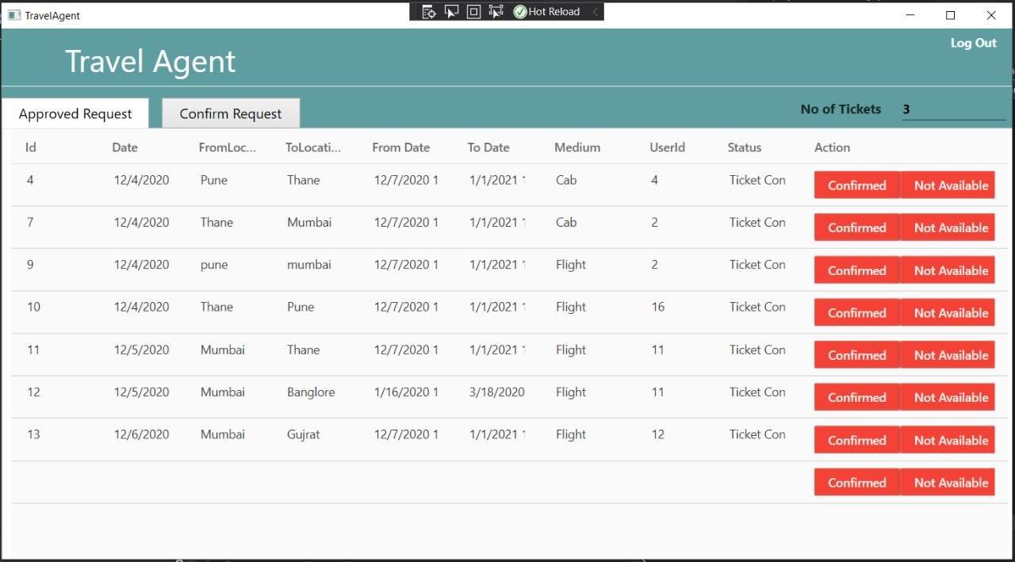

Slide 14
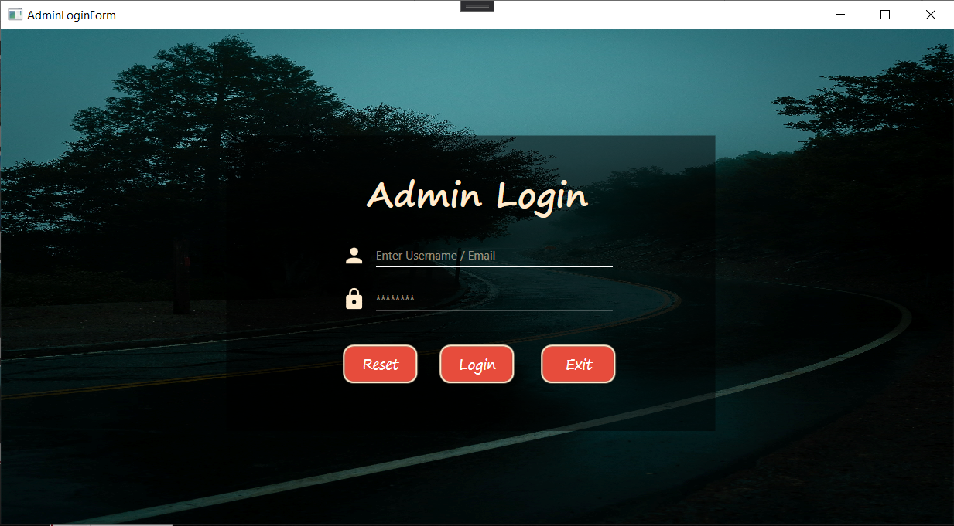

Slide 15
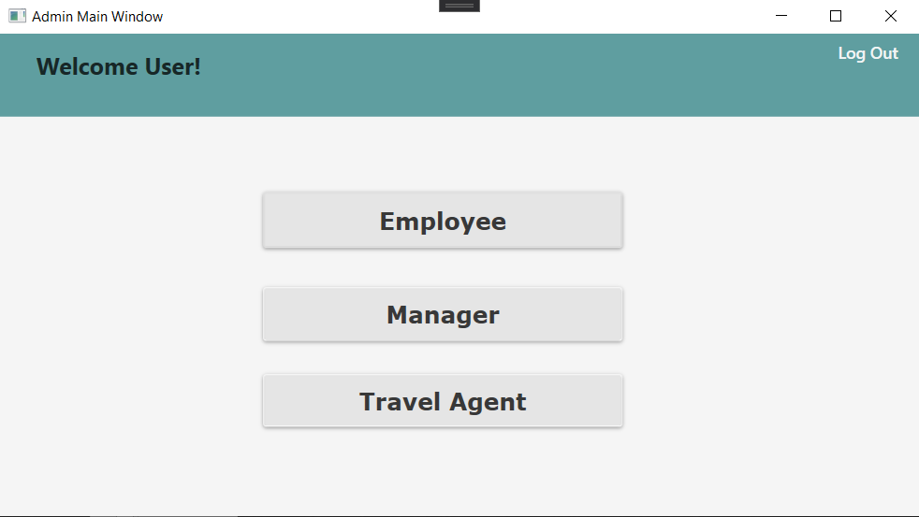

Slide 16
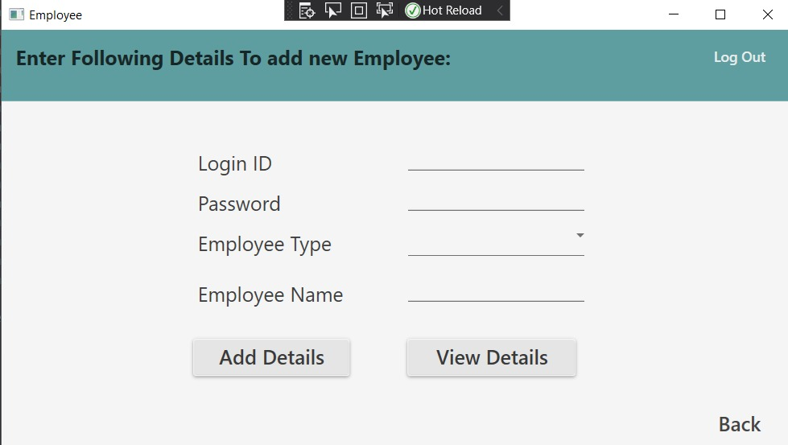

Slide 17
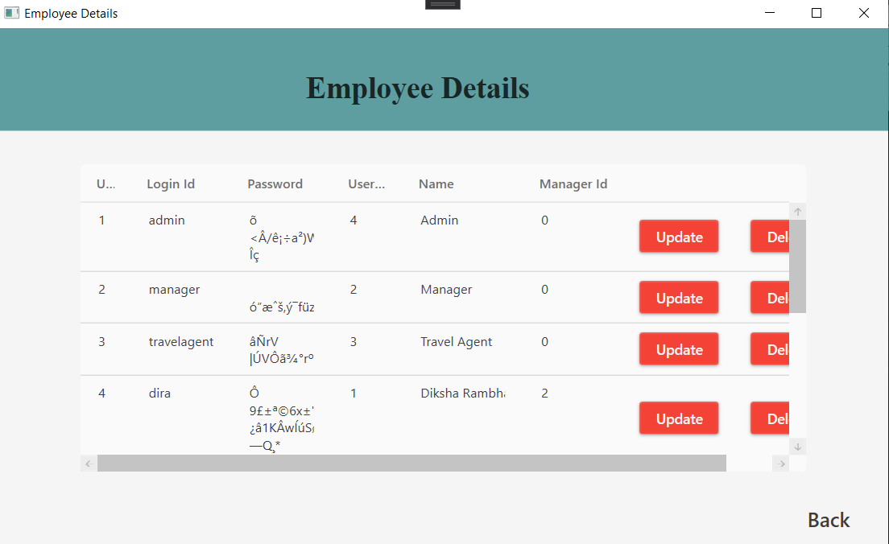

Slide 18
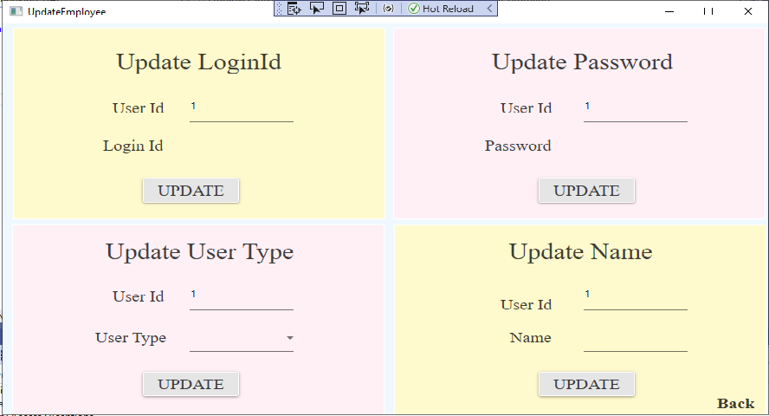

Slide 19
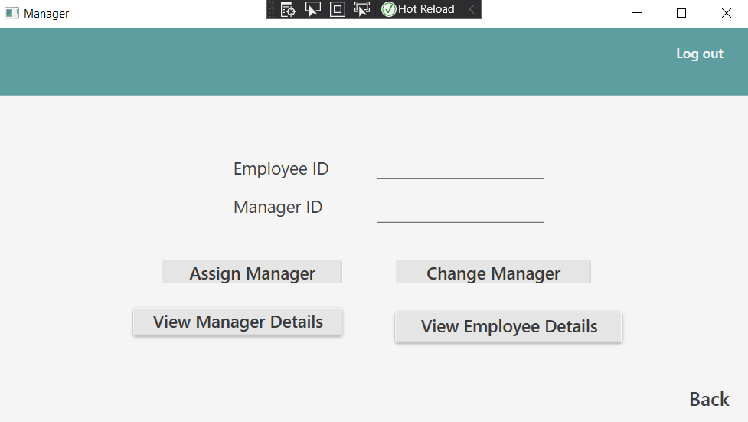

Slide 20
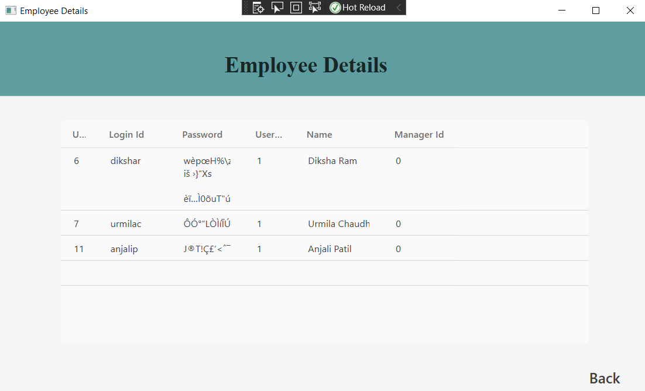

Slide 21
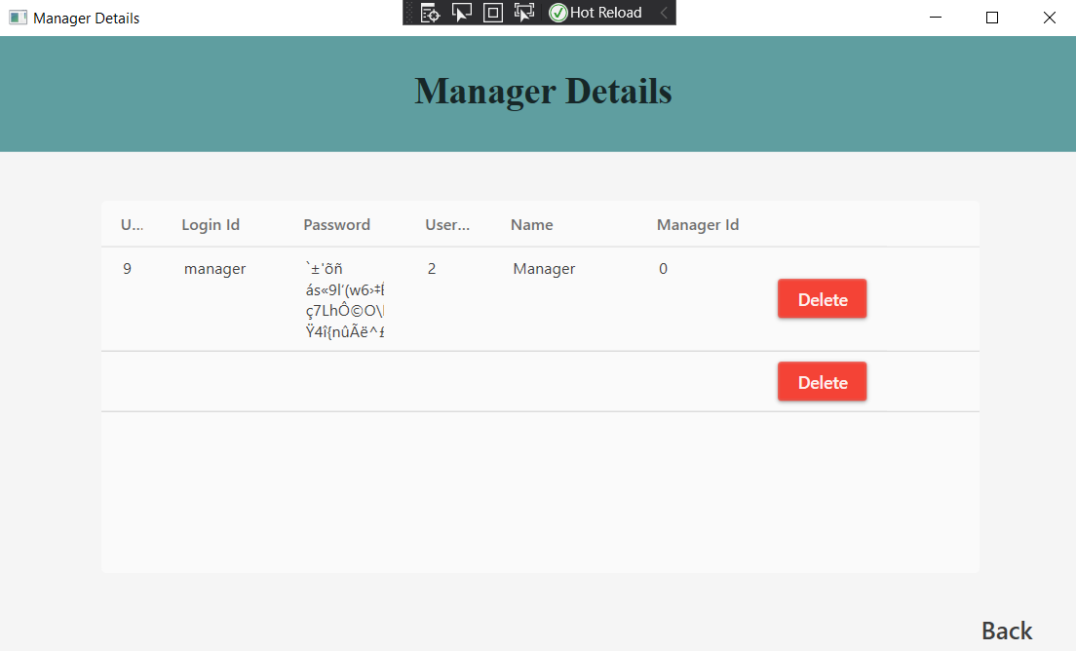

Slide 22
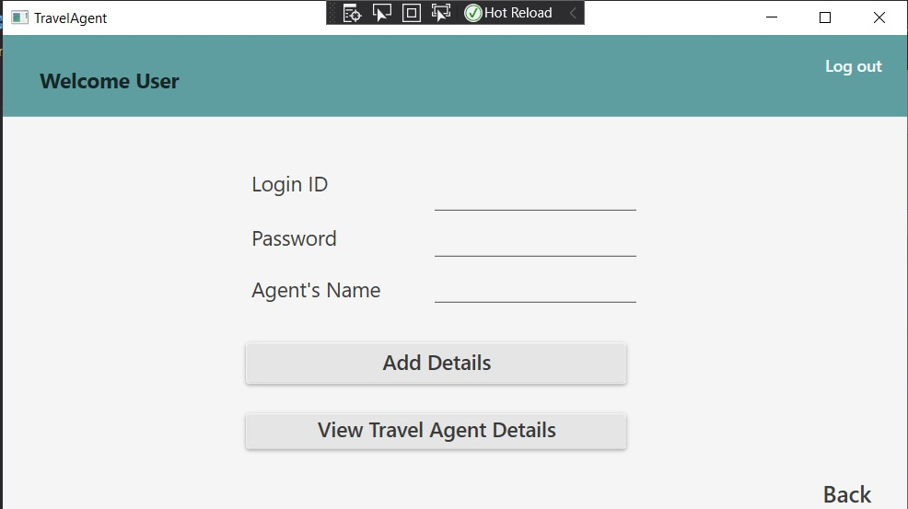

Slide 23
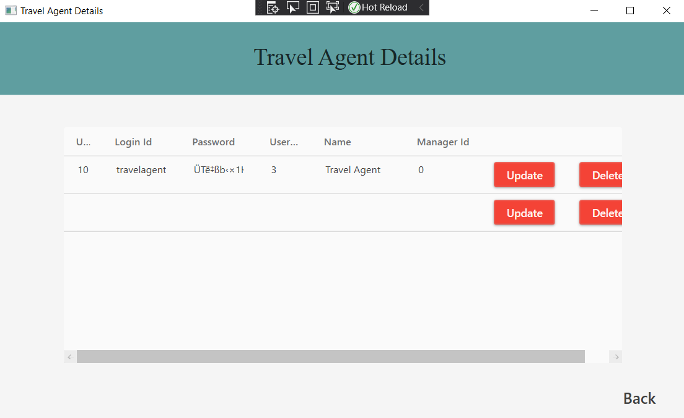

Slide 24
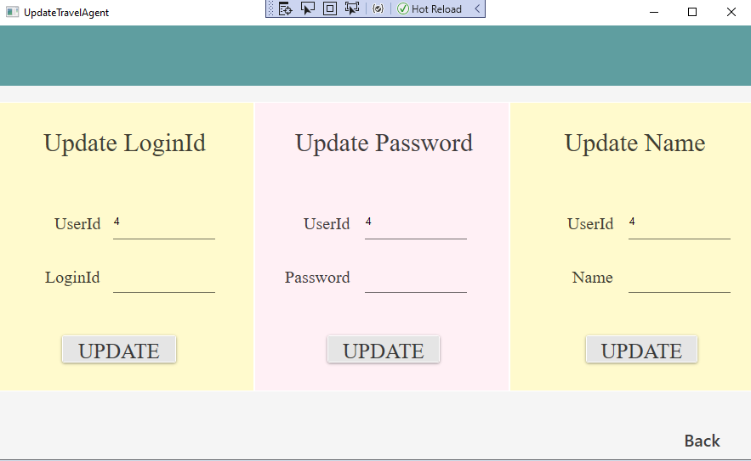

Slide 25
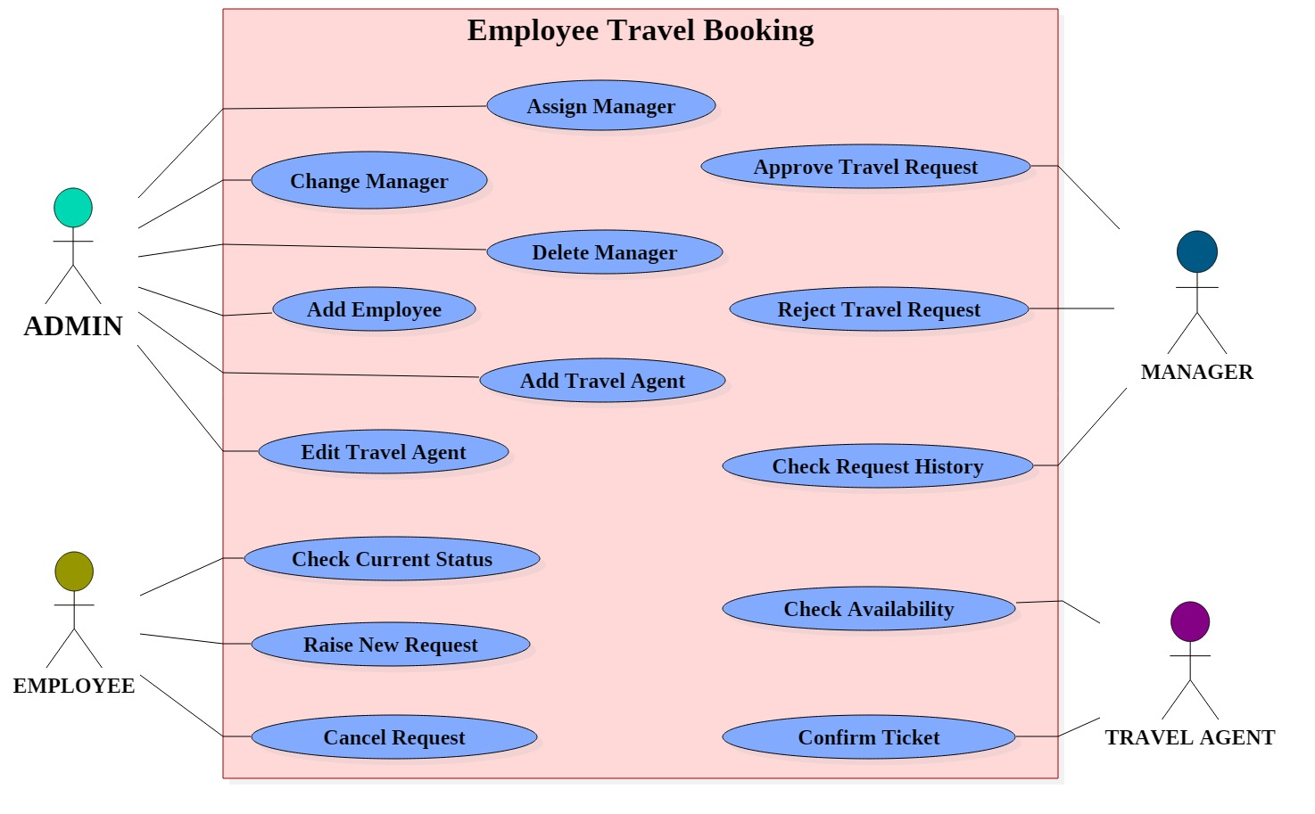
UML - Usecase Diagram

Slide 26
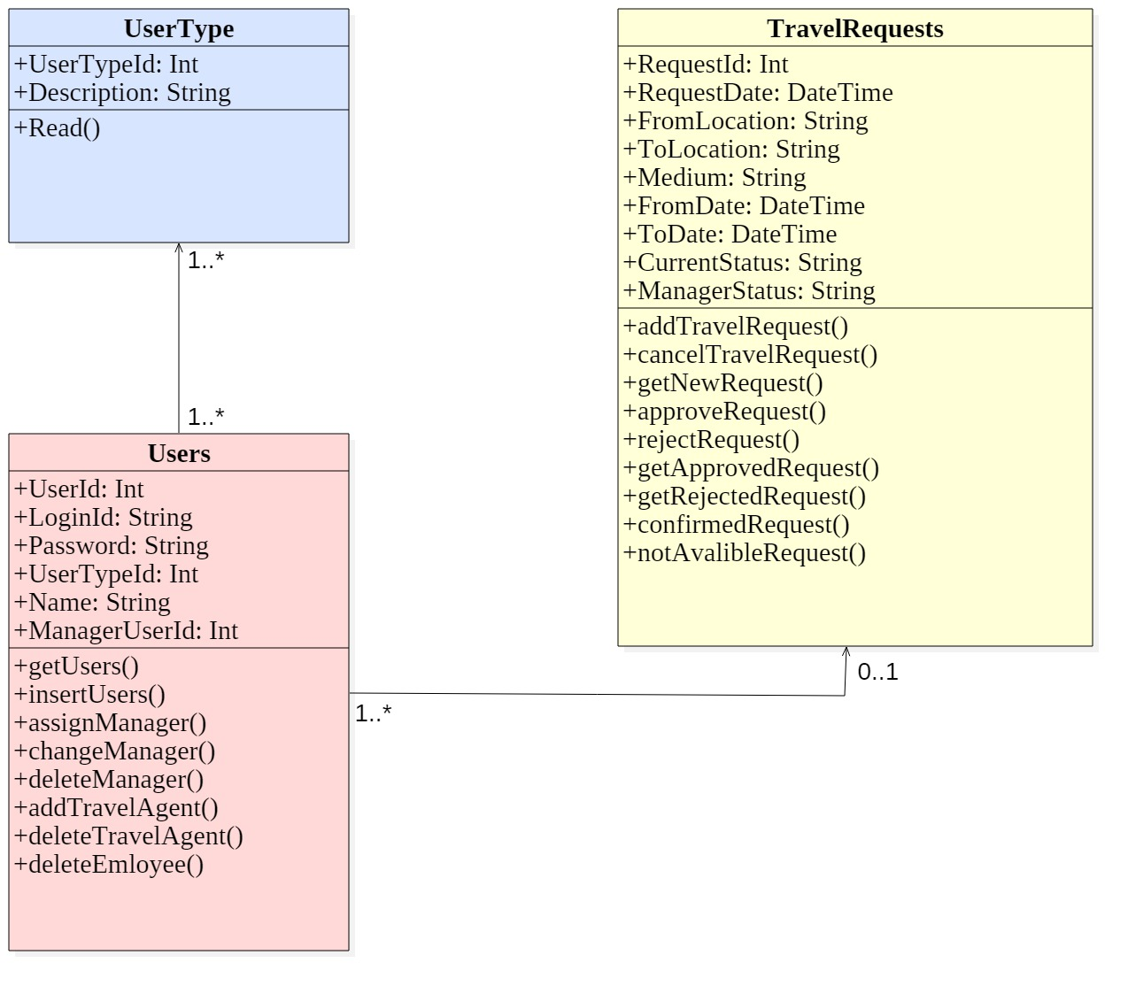
UML - Class Diagram

Slide 27
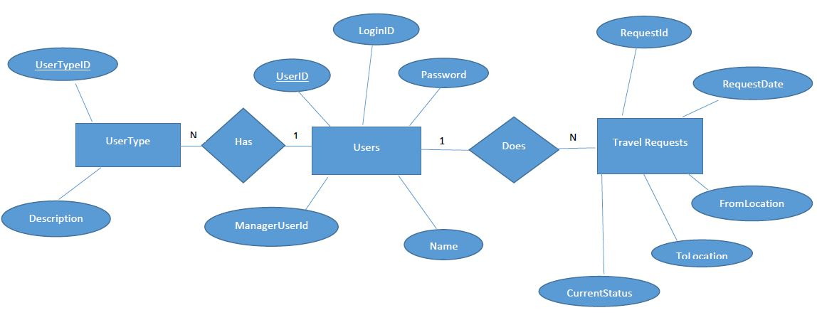
Database - ER Diagram

Slide 28
Thank You !

